Slide 1
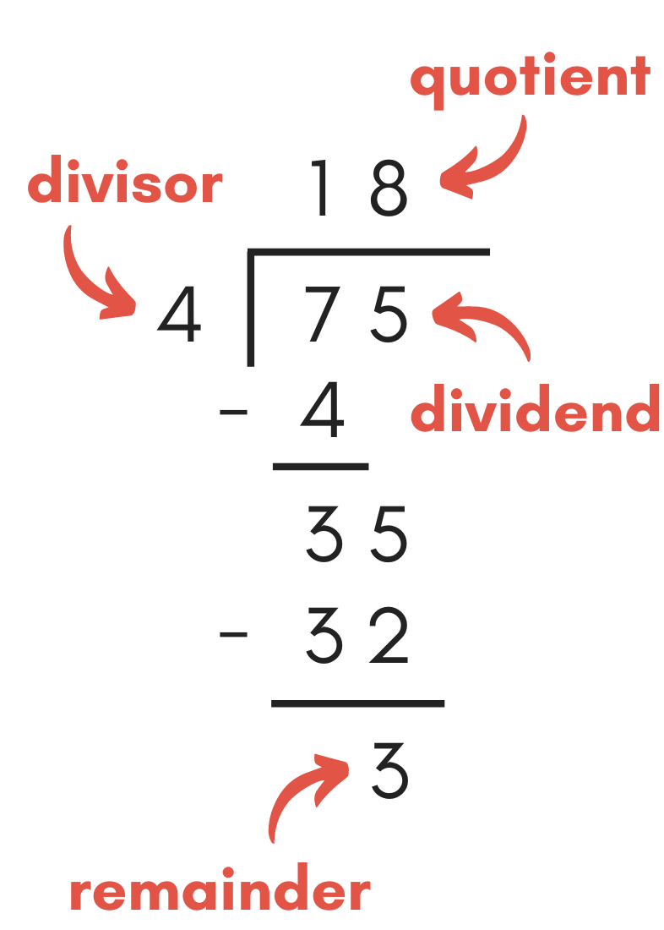
Chapter 04, 4.1 Divisibility and Modular Arithmetic
4.1.2 Division

Slide 2
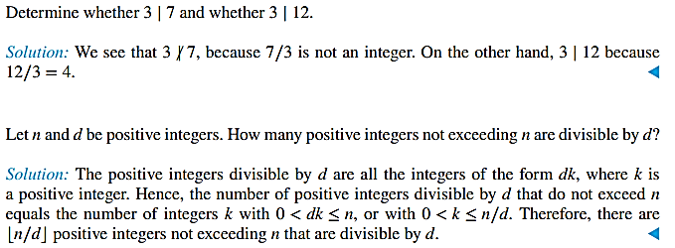
Chapter 04, 4.1 Divisibility and Modular Arithmetic
4.1.2 Division
When one integer is divided by a second nonzero integer, the quotient may or may not be an integer. For example, 12 ∕ 3 = 4 is an integer, whereas 11∕4 = 2.75 is not. This leads to Definition
If a and b are integers with a ≠ 0, we say that a divides b if there is an integer c such that b = ac (or equivalently, if b/a is an integer). When a divides b we say that a is a factor or divisor of b, and that b is a multiple of a. The notation a ∣ b denotes that a divides b. We write a̸| b when a does not divide b.
Remark: We can express a ∣ b using quantifiers as ∃c(ac = b), where the universe of discourse is the set of integers. In Figure 1 a number line indicates which integers are divisible by the positive integer d

Slide 3
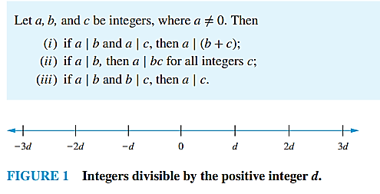
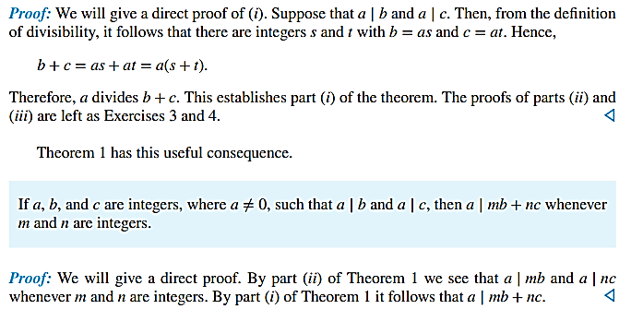
THEOREM 1
COROLLARY 1

Slide 4
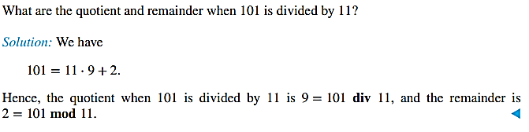
4.1.3 The Division Algorithm
When an integer is divided by a positive integer, there is a quotient and a remainder, as the division algorithm shows.
THE DIVISION ALGORITHM Let a be an integer and d a positive integer. Then there are unique integers q and r, with 0 ≤ r < d, such that a = dq + r.
In the equality given in the division algorithm, d is called the divisor, a is called the dividend, q is called the quotient, and r is called the remainder. This notation is used to express the quotient and remainder: q = a div d, r = a mod d.
Remark: Note that both a div d and a mod d for a fixed d are functions on the set of integers. Furthermore, when a is an integer and d is a positive integer, we have a div d = ⌊a∕d⌋ and a mod d = a − d.
What are the quotient and remainder when −11 is divided by 3?

Slide 5
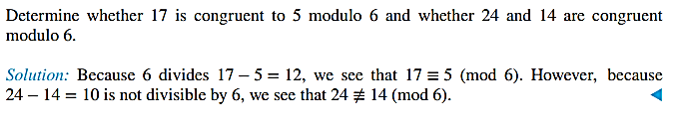
4.1.4 Modular Arithmetic
If a and b are integers and m is a positive integer, then a is congruent to b modulo m if m divides a − b. We use the notation a ≡ b (mod m) to indicate that a is congruent to b modulo m. We say that a ≡ b (mod m) is a congruence and that m is its modulus (plural moduli). If a and b are not congruent modulo m, we write a ≢ b (mod m).
Although both notations a ≡ b (mod m) and a mod m = b include “mod,” they represent fundamentally different concepts. The first represents a relation on the set of integers, whereas the second represents a function. However, the relation a ≡ b (mod m) and the mod m function are closely related.
THEOREM 3 Let a and b be integers, and let m be a positive integer. Then a ≡ b (mod m) if and only if a mod m = b mod m.

Slide 6
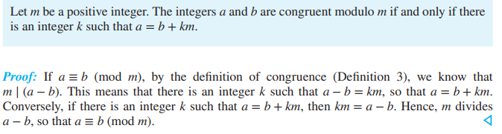
4.1.4 Modular Arithmetic
The set of all integers congruent to an integer a modulo m is called the congruence class of a modulo m. In Chapter 9 we will show that there are m pairwise disjoint equivalence classes modulo m and that the union of these equivalence classes is the set of integers. Theorem 5 shows that additions and multiplications preserve congruences.

Slide 7
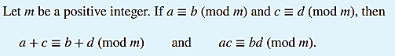
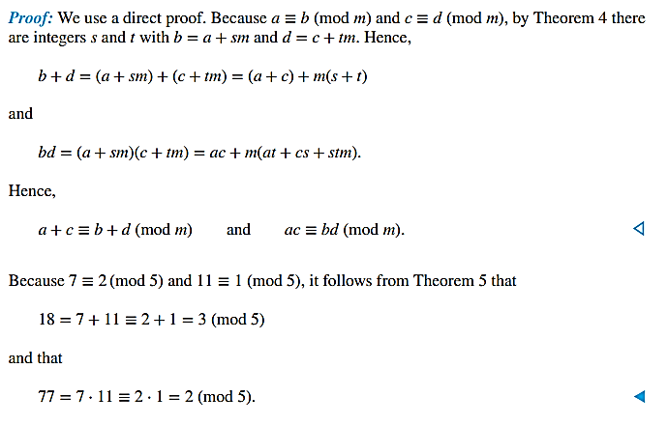
4.1.4 Modular Arithmetic

Slide 8
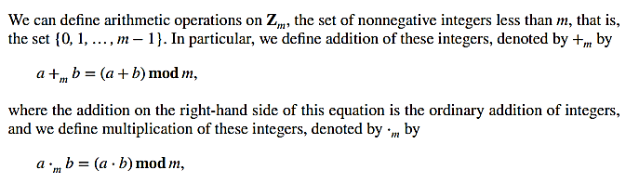
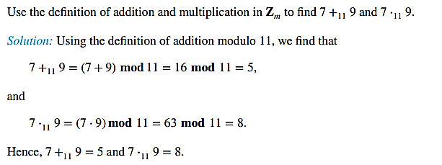
4.1.5 Arithmetic Modulo m

Slide 9
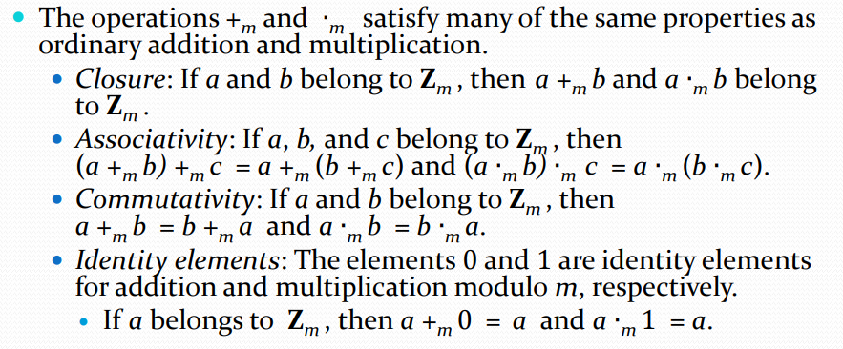
4.1.5 Arithmetic Modulo m

Slide 10
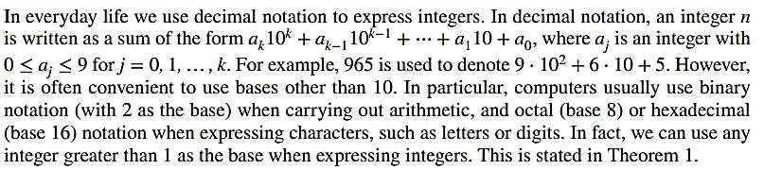
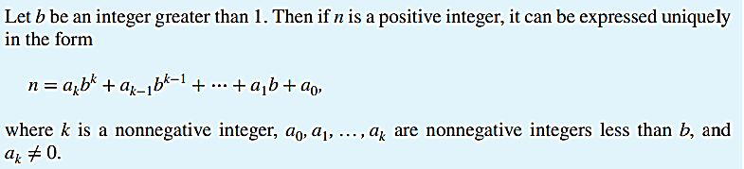
4.2 Integer Representations and Algorithms
4.2.2 Representations of Integers

Slide 11
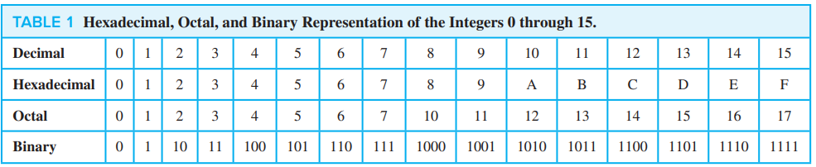
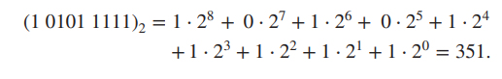
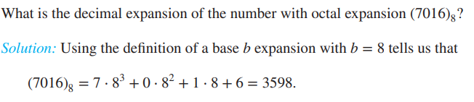
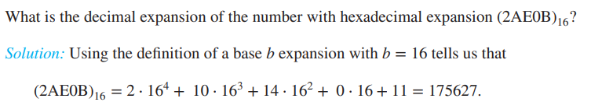
4.2 Integer Representations and Algorithms
4.2.2 Representations of Integers

Slide 12
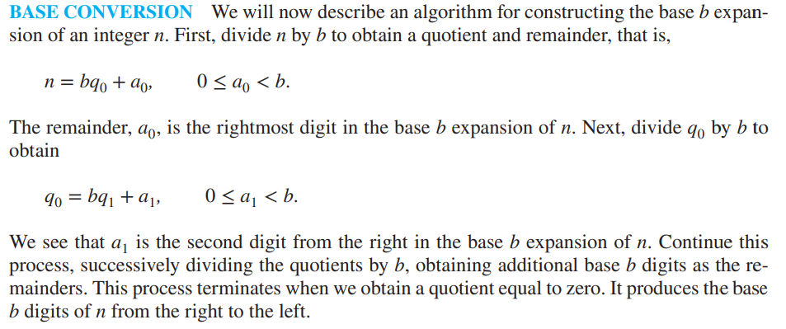
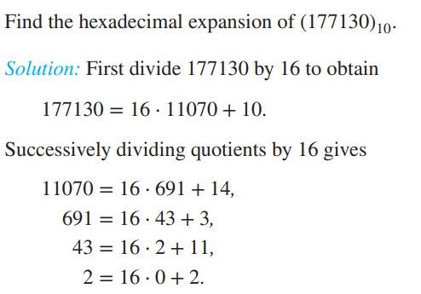
4.2 Integer Representations and Algorithms
4.2.2 Representations of Integers
The successive remainders that we have found, 10, 14, 3, 11, 2, give us the digits from the right to the left of 177130 in the hexadecimal (base 16) expansion of (177130). It follows that
(177130) 10 = (2B3EA) 16.

Slide 13
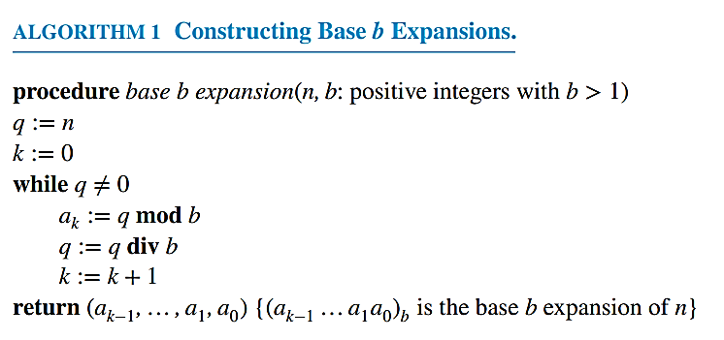
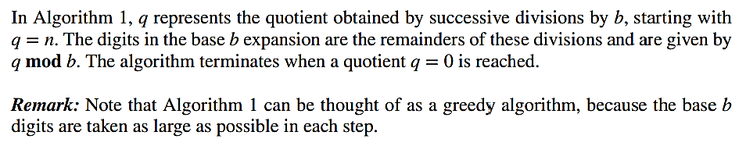
4.2 Integer Representations and Algorithms
4.2.2 Representations of Integers

Slide 14
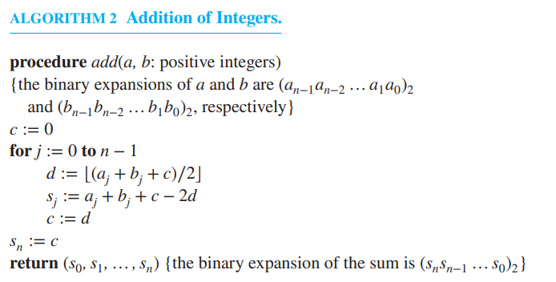
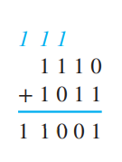
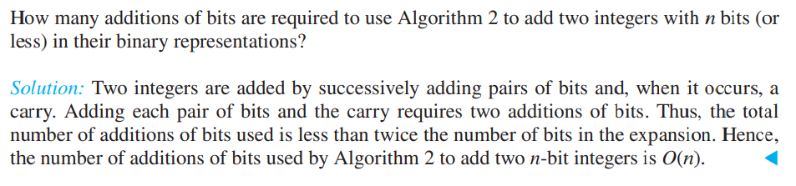
4.2 Integer Representations and Algorithms
4.2.2 Representations of Integers

Slide 15
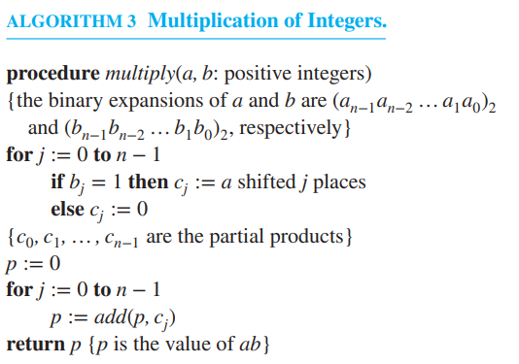
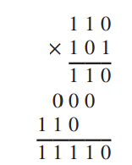
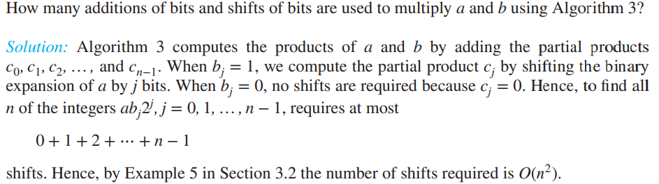

Slide 16
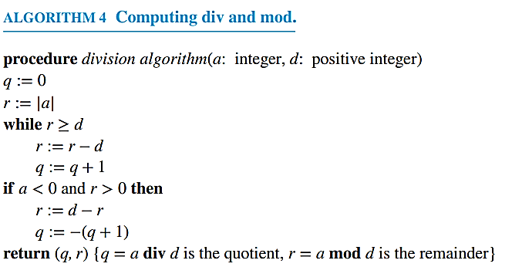
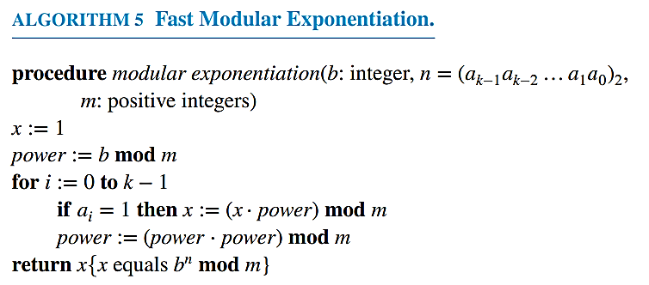

Slide 17
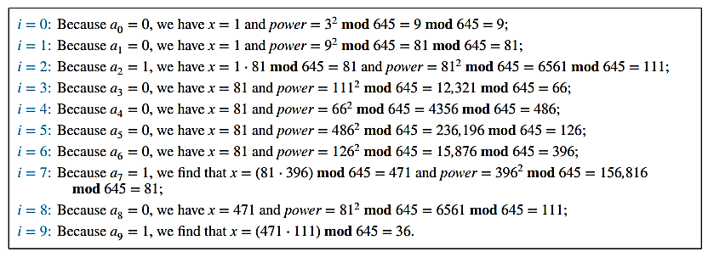
Use Algorithm 5 to find 3644 mod 645.
Solution: Algorithm 5 initially sets x = 1 and power = 3 mod 645 = 3. In the computation of 3644 mod 645, this algorithm determines 32j mod 645 for j = 1, 2, … , 9 by successively squaring and reducing modulo 645. If aj = 1 (where aj is the bit in the jth position in the binary expansion of 644, which is (1010000100)2), it multiplies the current value of x by 32j mod 645 and reduces the result modulo 645. Here are the steps used:
This shows that following the steps of Algorithm 5 produces the result 3644 mod 645 = 36.
Algorithm 5 is quite efficient; it uses O((log m) 2 log n) bit operations to find bn mod m

Slide 18
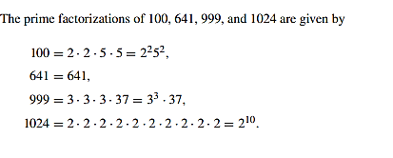
4.3 Primes and Greatest Common Divisors
An integer p greater than 1 is called prime if the only positive factors of p are 1 and p. A positive integer that is greater than 1 and is not prime is called composite.
Remark: The integer n is composite if and only if there exists an integer a such that a | n and 1 <a<n.
The integer 7 is prime because its only positive factors are 1 and 7, whereas the integer 9 is composite because it is divisible by 3.
The primes are the building blocks of positive integers, as the fundamental theorem of arithmetic shows.
THE FUNDAMENTAL THEOREM OF ARITHMETIC Every integer greater than 1 can be written uniquely as a prime or as the product of two or more primes where the prime factors are written in order of nondecreasing size.

Slide 19
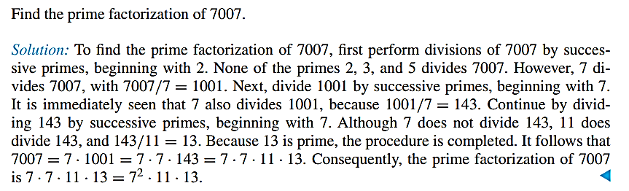
4.3 Primes and Greatest Common Divisors
Trial Division
If n is a composite integer, then n has a prime divisor less than or equal to √n.
Show that 101 is prime.
Solution: The only primes not exceeding √101 are 2, 3, 5, and 7. Because 101 is not divisible by 2, 3, 5, or 7 (the quotient of 101 and each of these integers is not an integer), it follows that 101 is prime.

Slide 20
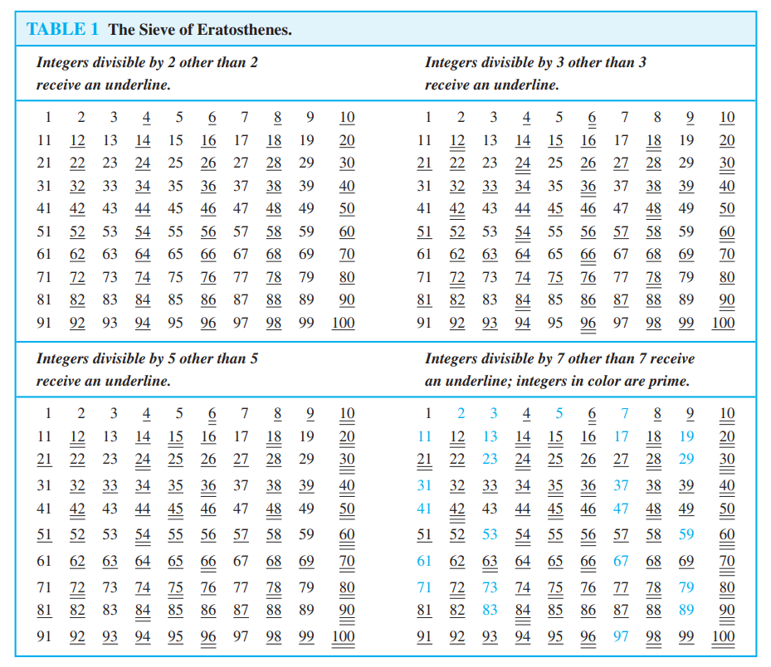
The Sieve of Eratosthenes
Note that composite integers not exceeding 100 must have a prime factor not exceeding 10. Because the only primes less than 10 are 2, 3, 5, and 7, the primes not exceeding 100 are these four primes and those positive integers greater than 1 and not exceeding 100 that are divisible by none of 2, 3, 5, or 7.
The sieve of Eratosthenes is used to find all primes not exceeding a specified positive integer. For instance, the following procedure is used to find the primes not exceeding 100

Slide 21
Mersenne Prime
Definition: Prime numbers of the form 2p − 1 , where p is prime, are called Mersenne primes.
There is an efficient test for determining if 2p − 1 is prime.
The largest known prime numbers are Mersenne primes.
As of mid 2011, 47 Mersenne primes were known, the largest is 243,112,609 − 1, which has nearly 13 million decimal digits.
The Great Internet Mersenne Prime Search (GIMPS) is a distributed computing project to search for new Mersenne Primes.
http://www.mersenne.org/

Slide 22
Conjectures and Open Problems About Primes
A conjecture is a mathematical statement that has not yet been rigorously proved. Conjectures arise when one notices a pattern that holds true for many cases. However, just because a pattern holds true for many cases does not mean that the pattern will hold true for all cases.
Many famous problems about primes still await ultimate resolution by clever people. Number theory is noted for its wealth of easy-to-understand conjectures that resist attack by all but the most sophisticated techniques, or simply resist all attacks. We present these conjectures to show that many questions that seem relatively simple remain unsettled even in the twenty-first century.
Goldbach’s Conjecture
The Twin Prime Conjecture
Goldbach's conjecture is one of the oldest and best-known unsolved problems in number theory and all of mathematics. It states that every even natural number greater than 2 is the sum of two prime numbers.
32 = 3 +29
But is it TRUE?
The twin primes conjecture concerns pairs of prime numbers with a difference of 2. The numbers 5 and 7 are twin primes. So are 17 and 19. The conjecture predicts that there are infinitely many such pairs among the counting numbers, or integers.

Slide 23
Greatest Common Divisor
Least Common Multiple

Slide 24
Greatest Common Divisor
Definition: Let a and b be integers, not both zero. The largest integer d such that d | a and also d | b is called the greatest common divisor of a and b. The greatest common divisor of a and b is denoted by gcd(a,b).
One can find greatest common divisors of small numbers by inspection.
Example: What is the greatest common divisor of 24 and 36?
Solution: gcd(24,36) = 12
Example: What is the greatest common divisor of 17 and 22?
Solution: gcd(17,22) = 1

Slide 25
Greatest Common Divisor
Definition: The integers a and b are relatively prime if their greatest common divisor is 1.
Example: 17 and 22
Definition: The integers a₁, a₂, …, a_{n} are pairwise relatively prime if gcd(a_{i}, a_{j})= 1 whenever 1 ≤ i<j ≤n.
Example: Determine whether the integers 10, 17 and 21 are pairwise relatively prime.
Solution: Because gcd(10,17) = 1, gcd(10,21) = 1, and gcd(17,21) = 1, 10, 17, and 21 are pairwise relatively prime.
Example: Determine whether the integers 10, 19, and 24 are pairwise relatively prime.
Solution: Because gcd(10,24) = 2, 10, 19, and 24 are not pairwise relatively prime.

Slide 26
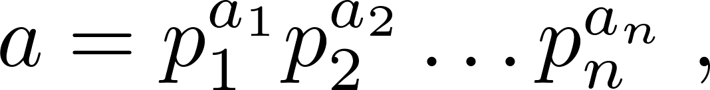
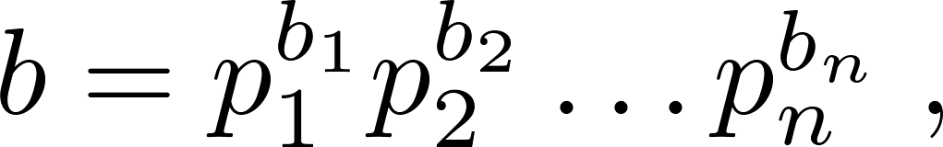
Greatest Common Divisor
Suppose the prime factorizations of a and b are:
where each exponent is a nonnegative integer, and where all primes occurring in either prime factorization are included in both. Then:
This formula is valid since the integer on the right (of the equals sign) divides both a and b. No larger integer can divide both a and b.
Example: 120 = 2³ ∙3 ∙5 500 = 2² ∙5³
gcd(120,500) = 2^{min(3,2)} ∙3^{min(1,0)} ∙5^{min(1,3)} = 2² ∙3⁰ ∙5¹ = 20
Finding the gcd of two positive integers using their prime factorizations is not efficient because there is no efficient algorithm for finding the prime factorization of a positive integer.

Slide 27
Least Common Multiple
Definition: The least common multiple of the positive integers a and b is the smallest positive integer that is divisible by both a and b. It is denoted by lcm(a,b).
The least common multiple can also be computed from the prime factorizations.
This number is divided by both a and b and no smaller number is divided by a and b.
Example: lcm(2³3⁵7², 2⁴3³) = 2^{max(3,4)} 3^{max(5,3)} 7^{max(2,0)} = 2⁴ 3⁵ 7²
The greatest common divisor and the least common multiple of two integers are related by:
Theorem 5: Let a and b be positive integers. Then
ab = gcd(a,b) ∙lcm(a,b)

Slide 28
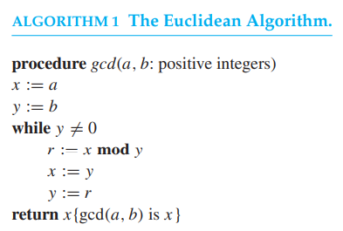
Computing the greatest common divisor of two integers directly from the prime factorizations of these integers is inefficient. The reason is that it is time-consuming to find prime factorizations. We will give a more efficient method of finding the greatest common divisor, called the Euclidean algorithm. This algorithm has been known since ancient times. It is named after the ancient Greek mathematician Euclid, who included a description of this algorithm in his book The Elements.
gcd(91, 287)
Find the greatest common divisor of 414 and 662 using the Euclidean algorithm.

Slide 29
gcds as Linear Combinations
An important result we will use throughout the remainder of this section is that the greatest common divisor of two integers a and b can be expressed in the form
sa + tb,
where s and t are integers. In other words, gcd(a, b) can be expressed as a linear combination with integer coefficients of a and b. For example, gcd(6, 14) = 2, and 2 = (−2) · 6 + 1 · 14.
BÉZOUT’S THEOREM If a and b are positive integers, then there exist integers s and t such that gcd(a, b) = sa + tb.
If a and b are positive integers, then integers s and t such that gcd(a, b) = sa + tb are called Bézout coefficients of a and b (after Étienne Bézout, a French mathematician of the eighteenth century). Also, the equation gcd(a, b) = sa + tb is called Bézout’s identity.

Slide 30
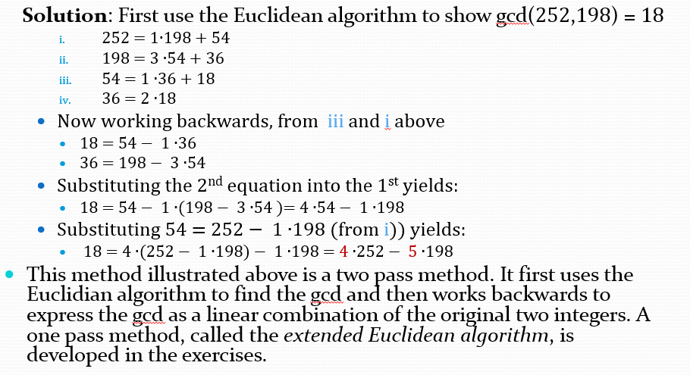
gcds as Linear Combinations
Express gcd(252, 198) = 18 as a linear combination of 252 and 198.

Slide 31
Thanks

Slide 32
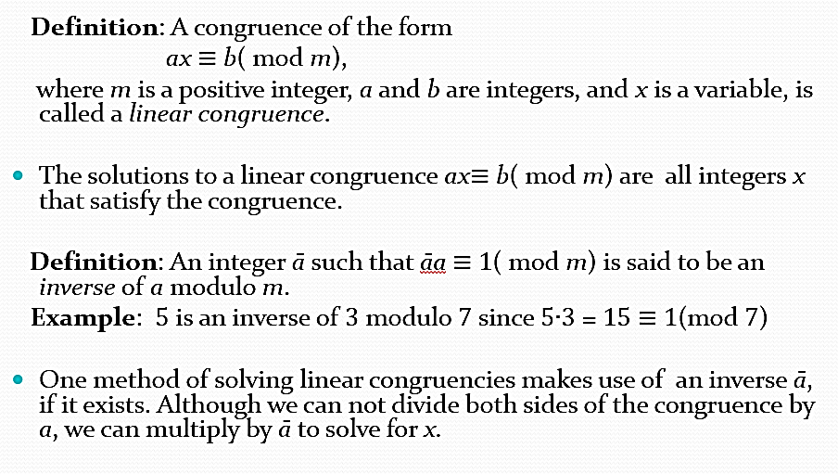
4.4 Solving Congruences

Slide 33
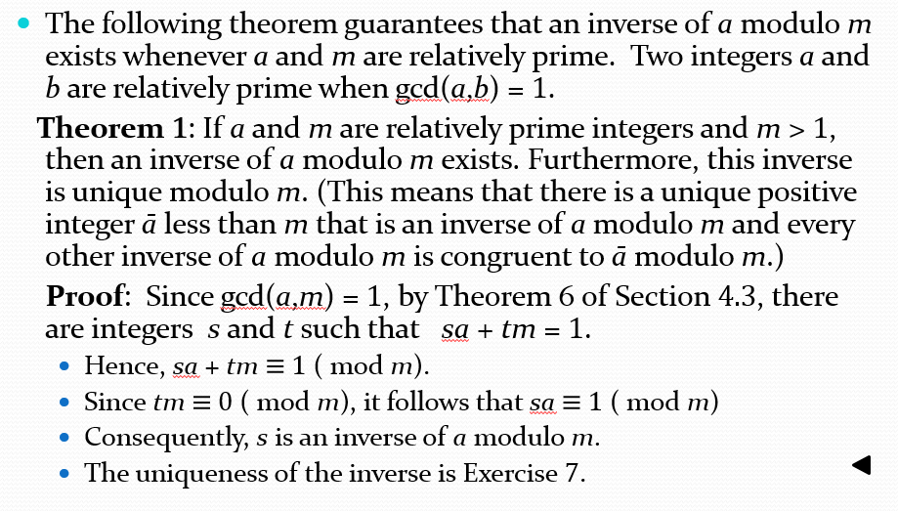
4.4 Solving Congruences

Slide 34
Dividing Congruencies by an Integer
LEMMA 2 If a, b, and c are positive integers such that gcd(a, b) = 1 and a | bc, then a | c.
LEMMA 3 If p is a prime and p | a1a2 ··· an, where each ai is an integer, then p | ai for some i.
EXAMPLE: The congruence 14 ≡ 8 (mod 6) holds, but both sides of this congruence cannot be divided by 2 to produce a valid congruence because 14/2 = 7 and 8/2 = 4, but 7 ≡ 4 (mod 6).
Although we cannot divide both sides of a congruence by any integer to produce a valid
congruence, we can if this integer is relatively prime to the modulus.
Theorem 7 establishes this important fact. We use Lemma 2 in the proof.
THEOREM 7 Let m be a positive integer and let a, b, and c be integers. If ac ≡ bc (mod m) and gcd(c, m) = 1, then a ≡ b (mod m).
Proof: Because ac ≡ bc (mod m), m | ac − bc = c(a − b). By Lemma 2, because
gcd(c, m) = 1, it follows that m | a − b. We conclude that a ≡ b (mod m).

Slide 35
Finding Inverses
Euclidean algorithm vs Extended Euclidean algorithm
3 modulo 7

Slide 36
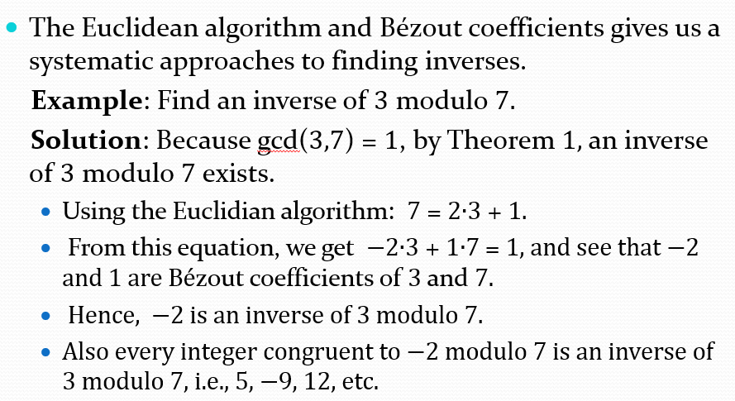
Finding Inverses

Slide 37
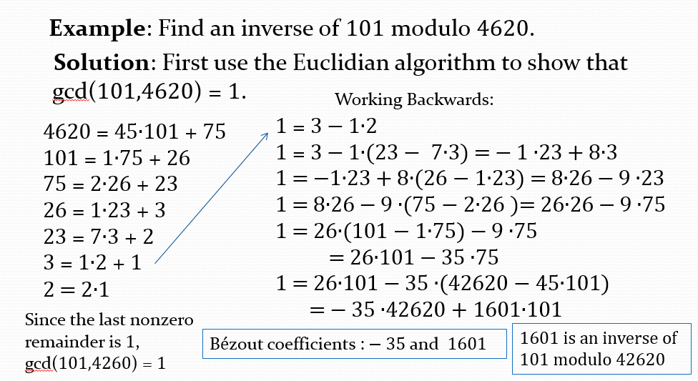
Finding Inverses

Slide 38
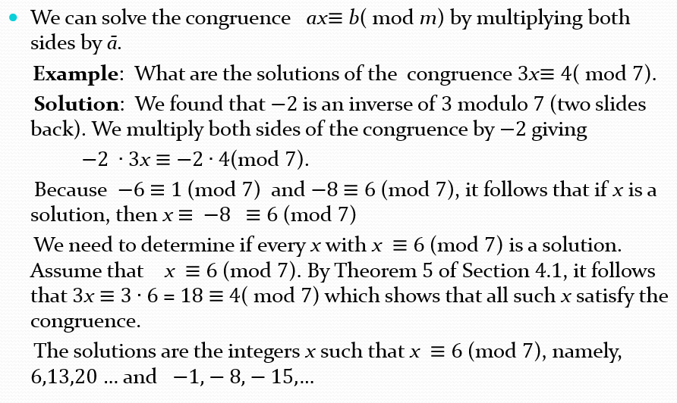
Using Inverses to Solve Congruences
FREE: For Complete Playlist: https://www.youtube.com/c/FahadHussaintutorial/playlists
For Code, Slide and Books: https://fahadhussaincs.blogspot.com/

Slide 39
Thanks

Slide 40
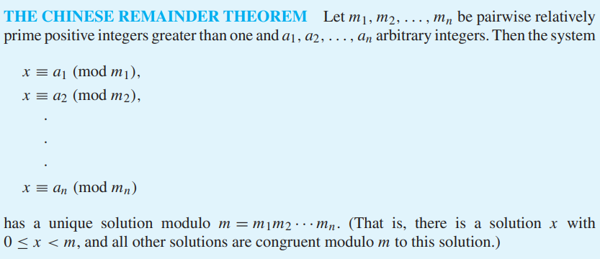
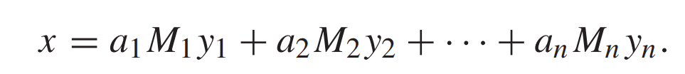
The Chinese Remainder Theorem
The Chinese remainder theorem, named after the Chinese heritage of problems involving systems of linear congruences, the Chinese remainder theorem says we can uniquely solve every pair of congruences having relatively prime moduli. x ≡ a mod m, x ≡ b mod n has a solution, and this solution is uniquely determined modulo mn. What is important here is that m and n are relatively prime. There are no constraints at all on a and b.

Slide 41
The Chinese Remainder Theorem
Word Problem:
Jessica breeds rabbits. She's not sure exactly how many she has today, but as she was moving them about this morning, she noticed some things. When she fed them, in groups of 5, she had 4 left over. When she bathed them, in groups of 8, she had a group of 6 left over. She took them outside to romp in groups of 9, but then the last group consisted of only 8. She's positive that there are fewer than 250 rabbits - but how many does she have?
Solution:
We have the following congurences
x ≡ 4 ( mod 5),
x ≡ 6 ( mod 8),
x ≡ 8 ( mod 9).
FREE: For Complete Playlist: https://www.youtube.com/c/FahadHussaintutorial/playlists
For Code, Slide and Books: https://fahadhussaincs.blogspot.com/

Slide 42
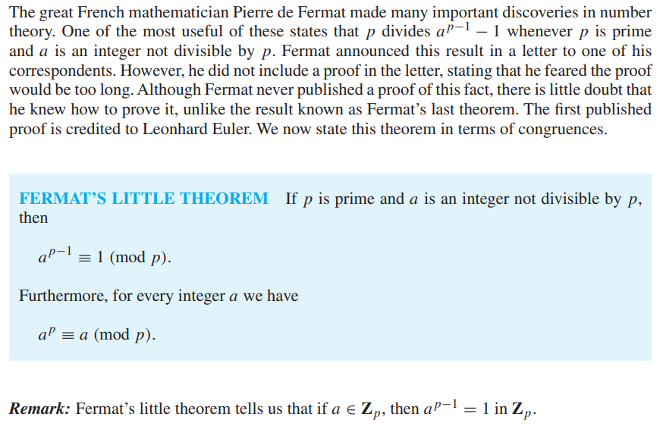
Fermat’s Little Theorem
FREE: For Complete Playlist: https://www.youtube.com/c/FahadHussaintutorial/playlists
For Code, Slide and Books: https://fahadhussaincs.blogspot.com/

Slide 43
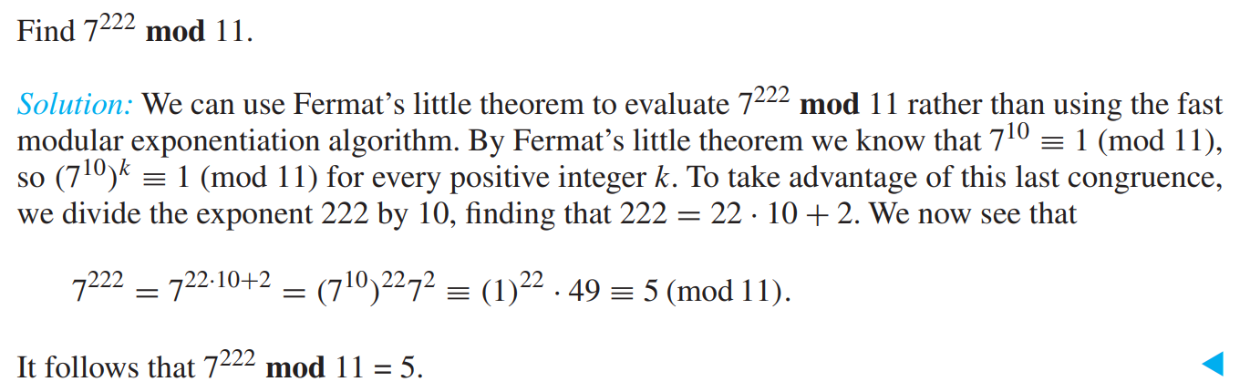
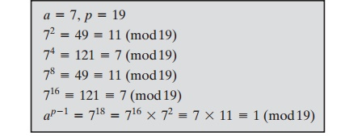
Fermat’s Little Theorem
FREE: For Complete Playlist: https://www.youtube.com/c/FahadHussaintutorial/playlists
For Code, Slide and Books: https://fahadhussaincs.blogspot.com/

Slide 44
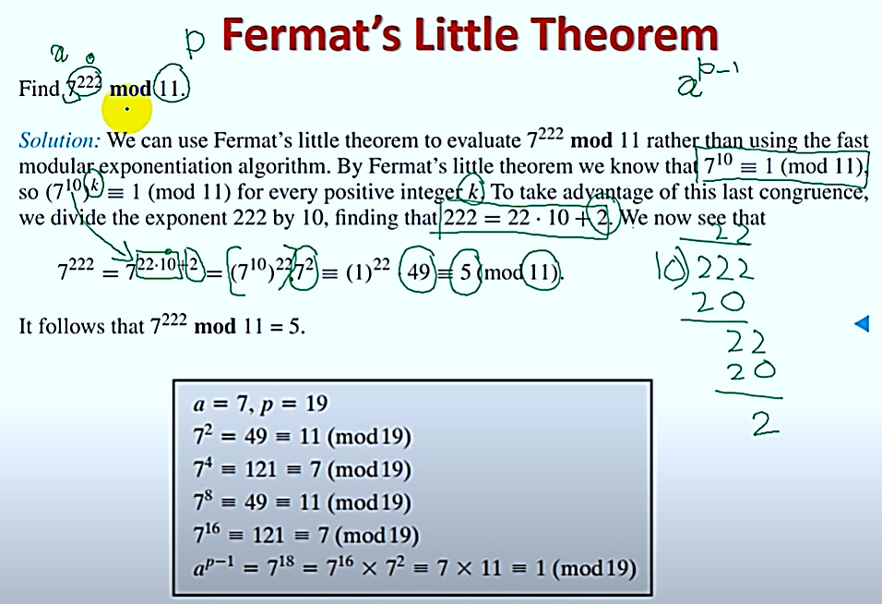
FREE: For Complete Playlist: https://www.youtube.com/c/FahadHussaintutorial/playlists
For Code, Slide and Books: https://fahadhussaincs.blogspot.com/

Slide 45
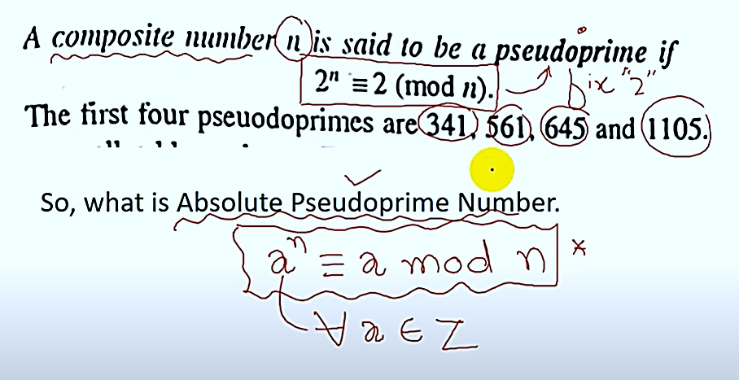
Pseudoprime
FREE: For Complete Playlist: https://www.youtube.com/c/FahadHussaintutorial/playlists
For Code, Slide and Books: https://fahadhussaincs.blogspot.com/

Slide 46

Pseudoprime

Slide 47


